Slide 1
Smile
Protection
Squad
Dylan, Ryan, and Sam

Slide 2
Toast Lovers!
You like toast
Ants also like toast
You do not want ants eating your toast
You must defend your toast from ants
You have an arsenal of sweets
Notes:
The name of our game is Toast Lovers. You like toast. Ants also like toast. You do not want ants eating your toast. So you must defend your toast from ants. You have an arsenal of sweets.
Toast Lovers! is a tower defense game where you must defend your toast from waves of ants with your arsenal of sweets.

Slide 3
Settings & Scenes
Game will include three maps:
a beginner kitchen mode
an advanced park mode
an expert campsite mode (at night)
Besides the game scene itself, there is also:
a menu scene
a help scene
Notes:
Our game scenes will (hopefully) consist of 3 maps if we have time, each with varying obstacles, wave composition, and entry points. We plan to have a kitchen themed beginner level, a park themed advanced level, and a campsite themed expert level. Aside from the game scenes, there will be a menu scene for the user to navigate through the game. There will also be a help scene that will include game instructions and descriptions of each unit. Now, here’s Dylan to walk through some scene mockups.

Slide 4
Main Menu
Toast Lovers!
Toast Lovers!
Play
Kitchen
Help
Park
Campsite
Smile Protection Squad
Back
Notes:
When you start playing, you are greeted with our beautiful main menu. This is a placeholder, because we are not artists (yet). It gives you the ability to select which map you wish to play on. As mentioned previously, you can choose the easy kitchen, the advanced park, or the expert campsite.

Slide 5
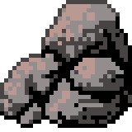

Game Screen
Long Range Tower
Toast (with Jam)
Controls
Playfield
Obstacles
Minimap
Shop
Long Range
Short Range
Sugar Farm
Honey Pot
Round Wall
Long Wall
30
25
80
60
10
15
Rock src: https://opengameart.org/content/rock-pile CC-BY
Notes:
(Note that all of these placeholder assets are public domain CC0 unless otherwise noted.) The game screen is split into three sections:
A minimap
A shop
And a playfield
Here, we see (again in placeholder form) what the screen looks like with nothing selected in between rounds. The player is free to create new towers and select current ones. In the shop section, we see all of the towers that we have the ability to create. But let's say that we want to upgrade a tower... (ADVANCE SLIDE)

Slide 6
Game Screen
Selected Tower
Playfield
Minimap
Shop
Increase Range
Increase Fire Rate
Increase Effect
Increase Accuracy
20
20
20
20
Notes:
We see that the shop has transformed into a location where we can upgrade statistics of the towers. The playfield has also been redrawn to show us the tower's range, and the sprite has been lightened. You can click off of the selected tower to return to the previous slide. Upon pressing play... (ADVANCE SLIDE)

Slide 7
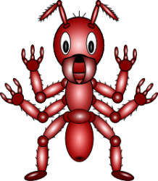
Game Screen
Controls
Playfield
Minimap
Shop
Long Range
Short Range
Sugar Farm
Honey Pot
Round Wall
Long Wall
30
25
80
60
10
15
Notes:
We then get to see the path that the ants follow as they try to reek havoc on your eating habits. The ants always flow from off the screen to on the screen, but a new path is calculated at the start of every round from a random position along the edge. You hopefully, you have placed your towers appropriately. All of the ants specified by the wave will march down the path. Here's Ryan again to tell you more about them!

Slide 8
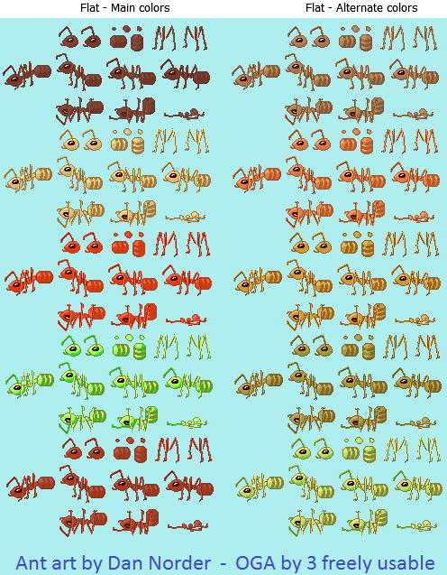
Ants
Ants can take numerous forms:
normal
strong & slow
extra fast
Notes:
The ant units we will be defending our toast from will have 3 different types. A normal ant, a strong but slow ant, and a weak but fast ant.

Slide 9
Towers
There are six kinds of towers:
the main toast object to defend
long range ant appeasement units
short range ant appeasment units
static obstacle & wall units
disposable honeypot units
loot farm units
Notes:
Towers are units that will interact with ants.
These include:
The main toast object to be defend from ants, Long and short range ant appeasement units, Static obstacles, Disposable honeypot units, and loot farm units.
Now, Sam will go over the mentioned towers in depth.

Slide 10
Toast
This is the tower you must defend or else you will lose
you cannot move it
it has a set amount of health
Notes:
The toast will be located in the middle of the map. All of the ants will be trying to reach the toast. Your goal is to prevent the ants from consuming the toast.

Slide 11
Ant Appeasement Units
They appease the ants with sugar, they do not kill
Long range:
fires a shot in one direction at a time
single shot goes a fair way to appeasing an ant
Short range:
fires shots in eight directions at a time
weaker shots but can be rapidly fired
Notes:
These towers prevent the ants from reaching the toast by firing sugar at the ants to appease their desire for food. No ants will be harmed in the making of this game. There’s a long range tower that fires sugar at a long range, has a slow firing speed, and each shot appeases the ant quite a bit. There’s also a short range tower that fires quickly, appeases less with each shot, and has less range.

Slide 12
Wall & Obstacle Units
Force ants to waste time navigating the course
long objects like sticks and silverwave
rounder objects like rocks and plates
ants can walk around them with additional distance
ants can walk over them with much slower movement
Notes:
There are also obstacles the player can place onto the map that will slow down the ant’s progress towards the toast. Ants will walk around them unless the cost of walking over them at a greatly reduced speed will be less than walking around them

Slide 13
Honeypots
Honeypots are a strategic tower that can attract ants away
requires fewer to keep ants away from the entire tower
has significantly less health than a static wall
Notes:
Honeypots are towers that attract the ants away from the toast. The ants will eat away at the honeypot until it is gone. While ants are eating it, they will gain appeasement at a slow rate.

Slide 14
Honeypots
Notes:
Here’s an example of how the honeypots will redirect the path of the ants.

Slide 15
Loot Farms
Generates additional revenue for you to build other towers with
has less health than a honey pot, but also attracts ants
ants attack it for strategic value
vital for survival in the long term
Notes:
Loot farms are a tower that will generate some form of currency for the player to purchase towers and upgrades from the shop. It also attracts ants and will be destroyed by them if not protected.

Slide 16
Technical Requirements
There are more than 3 scenes: a main menu, a help menu, and 3 different game scenes.
There are more than 3 types of gameobjects: ants, towers, pellets, and a large number of subobjects.
There are two camera views: the main view and the minimap.
Ant movement uses either interpolation.
The physics engine and pixel collisions are both used to detect if a sugar pellet hits an ant.
Notes:
Time for stuff that's boring but important! Scene-wise, the main menu and help menu may completely cover this on their own (we are still trying to figure out how to implement it all), and there are 3 game scenes to choose from.
There are far more than three types of game objects, but towers, pellets, and ants cover this on their own at the high level.
The game scenes all have a minimap in addition to their gameview.
Ants move between the squares using interpolation, but bullets make usage of the physics engine and pixel collisions to move and collide with the invading ants.

Slide 17
Technical Requirements
The game worlds all use different lighting setups to provide the desired effects.
the kitchen has a several point lights
the park has a directional light to represent sun light
the night has light emitting from different game objects, rather than from above
Objects will all respond to lights to cast shadows, and will have normal maps generated to look good at the same time.
The UI is so easy a middle schooler could use it. It will (hopefully) be fun.
Notes:
We make excessive usage of lighting throughout the game worlds. The kitchen uses point lights, because that's how kitchens work. The park has sunlight, so we use a directional light, and it will animate by rotating around the map, casting shadows in a different direction. The night area will have a flickering point light from many of the towers. Objects will have normal maps applied to them, and will cast shadows because they look cool.
The UI is about as easy as it possibly can be for a game like this. We can only hope that the game will be fun, but it probably will be.

Slide 18
Schedule
By 2018-02-26:
Get something onto the screen
Have a graph that objects can be placed on
Pathfinding from point to point that can work around obstacles
Internally a bunch of engine stuff will be worked on (e.g. tower stats/inheritance)
By 2018-03-05:
UI should be mostly complete
Ants will march down the path and target toast and honeypots
Towers can be placed, sold, upgraded, and destroyed
Should be able to mostly play the game, but a bit unpolished
Notes:
For our progress demo, we’ll basically get the core game elements implemented and working. This includes the graph/grid for our units to be placed on and pathfinding for the Ant units on the graph. Also, tower units should be somewhat functional.
Our playtest will be a playable level with all core game elements fully implemented but unpolished.

Slide 19
Schedule
By 2018-03-12:
Polish! Polish! Polish!
Settings will be tweaked for additional balance
Help menu will be made
Maybe implement particle systems
Game will be done
Notes:
Our final game will be similar to our playtest version with lots of polishing and tuning from the feedback we receive. The game will be done and possibly have extra features and levels.

